Slide 1
Breakout Mentors Showcase By Jay Sampat
Name: Jay Sampat
Age: 11
Mentor: Matthew Daniel
Project: Chess game in Scratch Programming

Slide 2
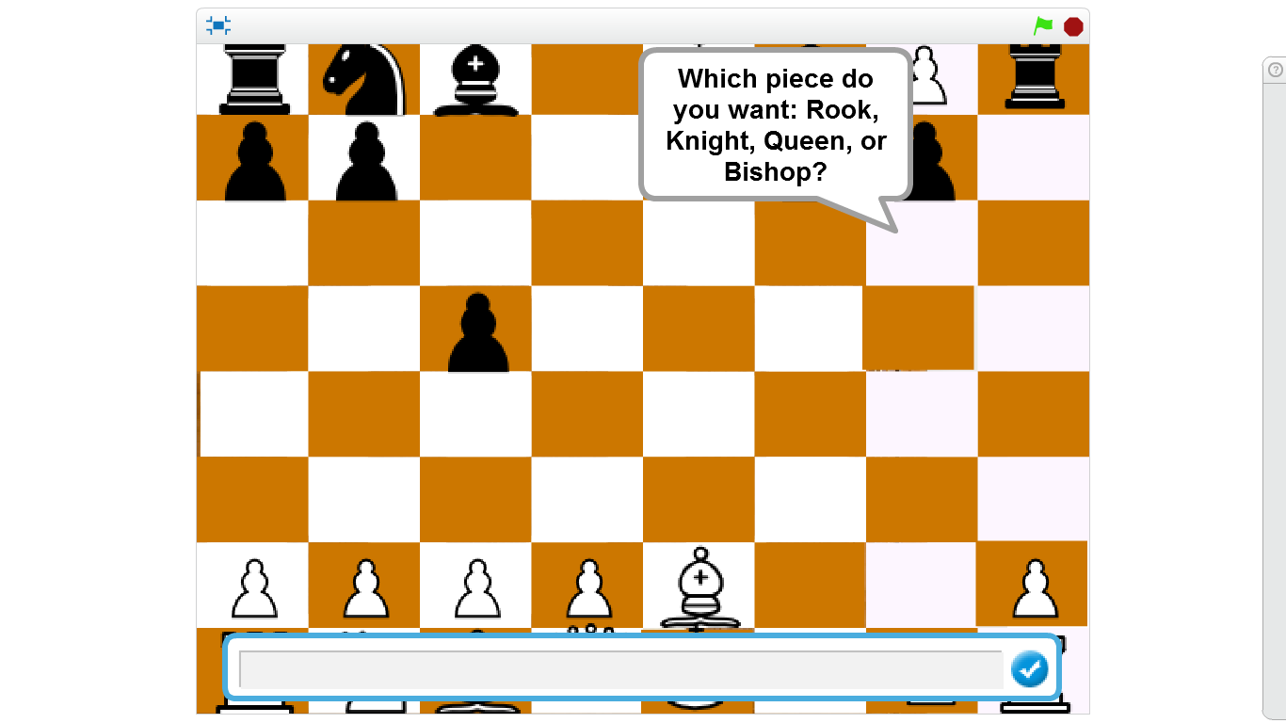

Slide 3
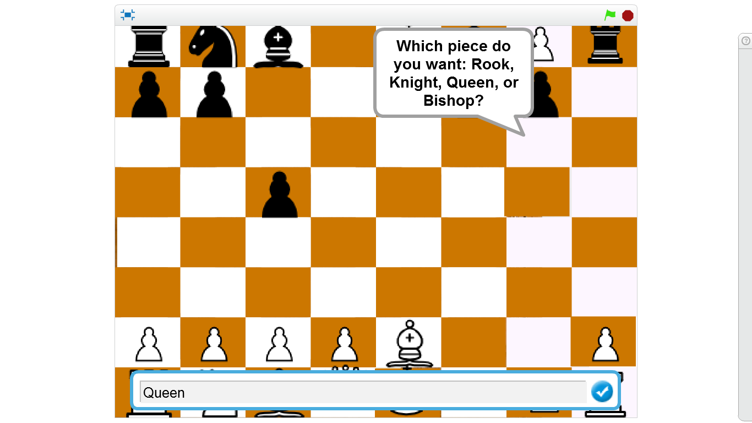

Slide 4
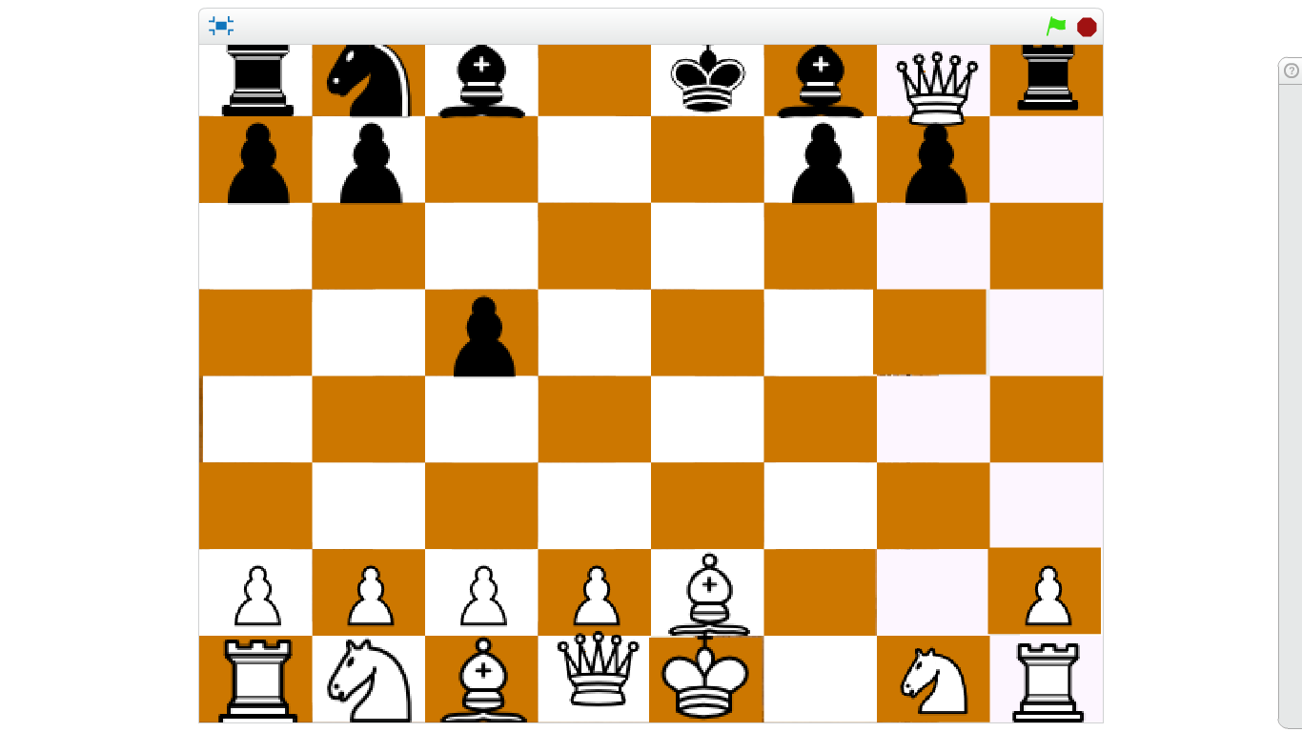

Slide 5
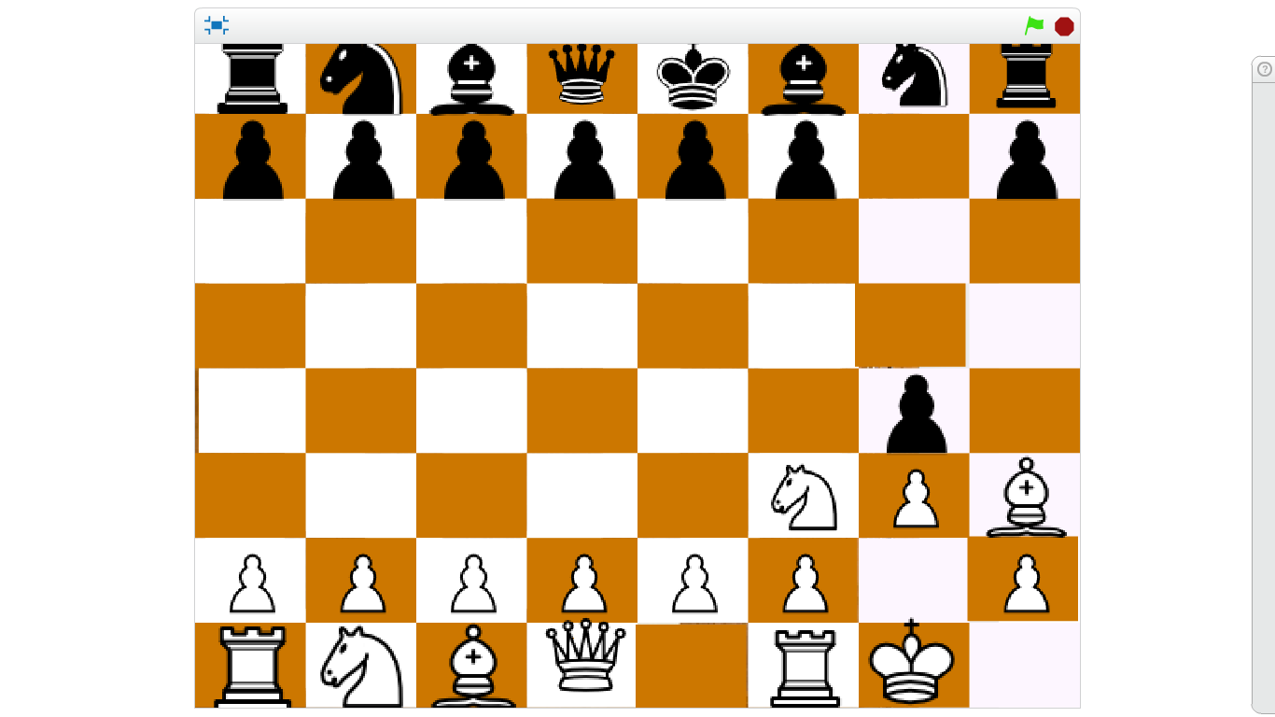

Slide 6
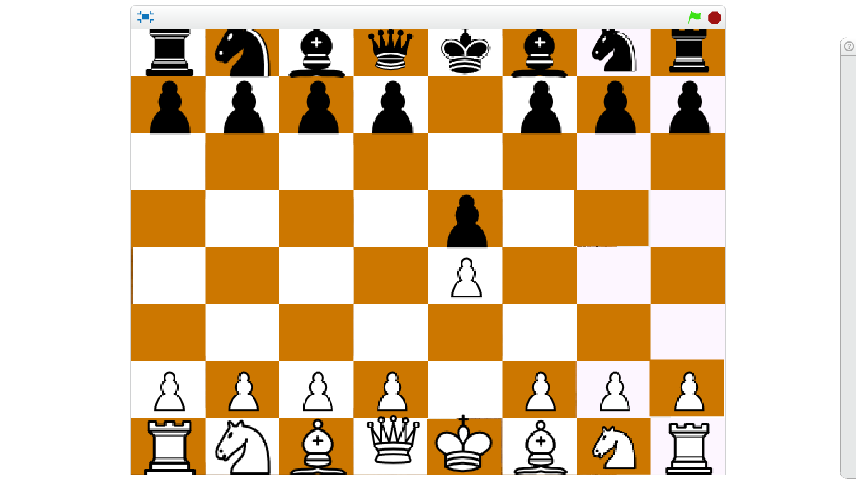

Slide 7
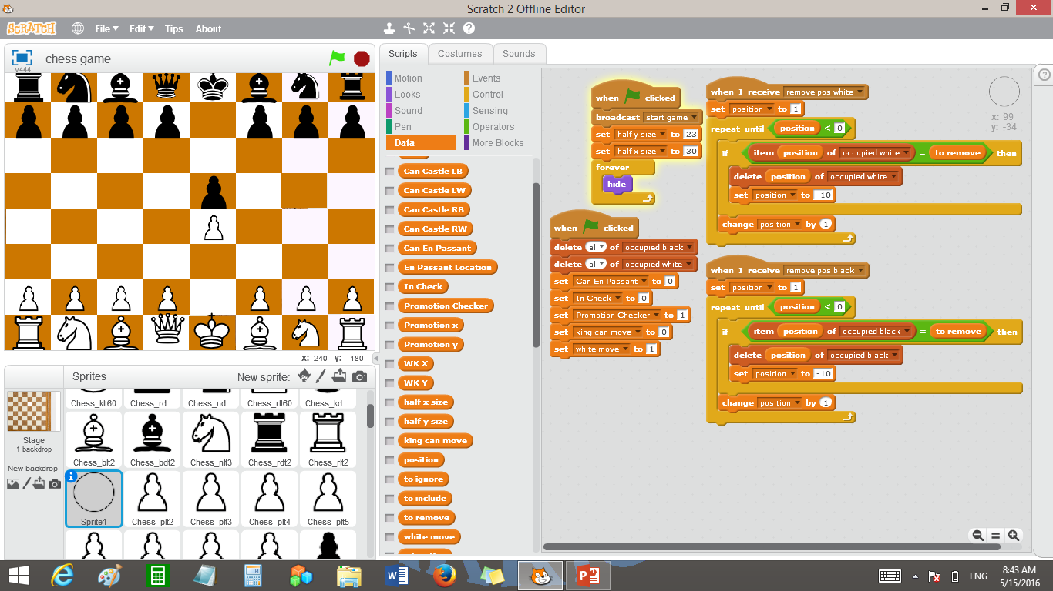

Slide 8
